Slide 1
Recent Spanish developments on renewables and some consequences
José M. Martínez-Duart, Univ. Autónoma Madrid
Jorge Hernández-Moro, Univ. Autónoma Madrid
Silvia Serrano, Polytechnic Univ. Madrid
Roberto Gómez-Calvet, European Univ. Valencia
Meeting Energy Group, European Physical Society
Lisbon, November 13-14, 2014
European Energy Group Meeting, EPS, Lisboa, Nov. 13-14, 2014

Slide 2
Arguments for the strong development of Renewables in Spain
Large available resources and economic potentials like solar, wind, etc.
Help in balance of payments
Energy autonomy and security
Lower C emissions
International compromises (European 20-20-20) Directive, Kioto Protocole, etc.
European Energy Group Meeting, EPS, Lisboa, Nov. 13-14, 2014

Slide 3
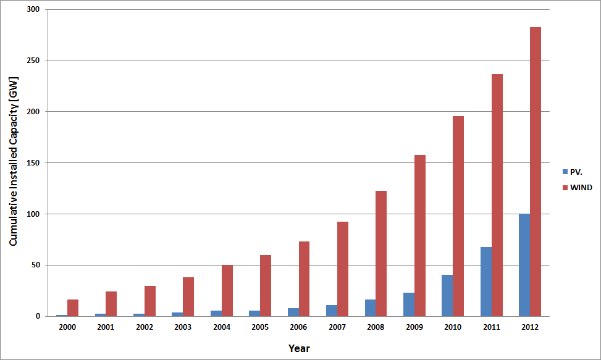
Evolution of global PV and Wind cumulative installed capacity (GW)
European Energy Group Meeting, EPS, Lisboa, Nov. 13-14, 2014

Slide 4
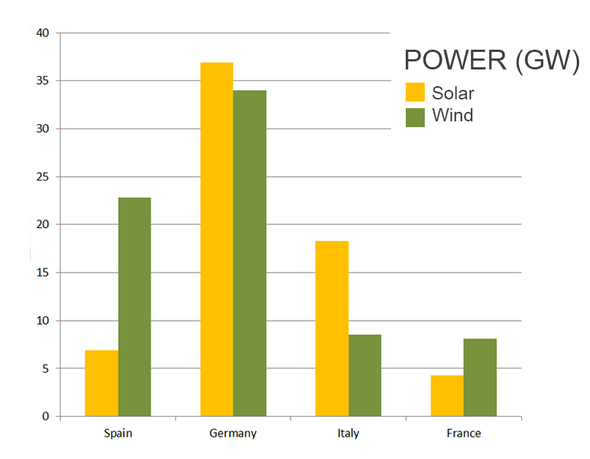
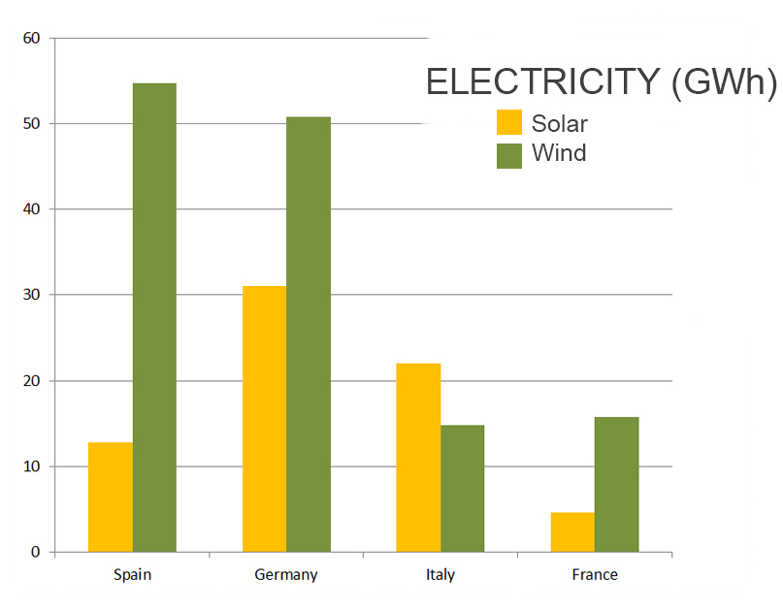
RENEWABLE POWER & ENERGY (2013)
SEVERAL EUROPEAN COUNTRIES
Spain Germany Italy France
Spain Germany Italy France
CAPACITY FACTORS | SPAIN | GERMANY | ITALY | FRANCE
SOLAR | 21% | 10% | 14% | 12%
WIND | 27% | 17% | 20% | 22%

Slide 5
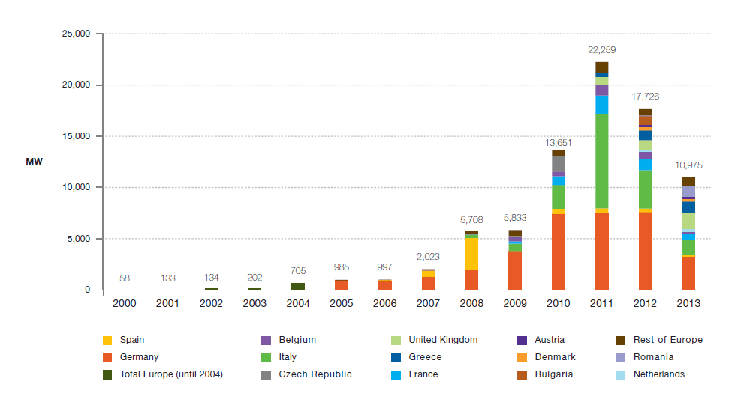
Evolution of European new grid-connected PV power Capacity (MW)
-Observe that most PV systems in Spain were mounted in 2007-2008 with expensive system costs (the L. C. did not decrease in those years). However, in 2011-2013, when the modles were cheap, inversions in PV were practically null. On the contrary, Germany has shown a very continuous growth. The growth of PV in Italy during the last years has been remarkable

Slide 6
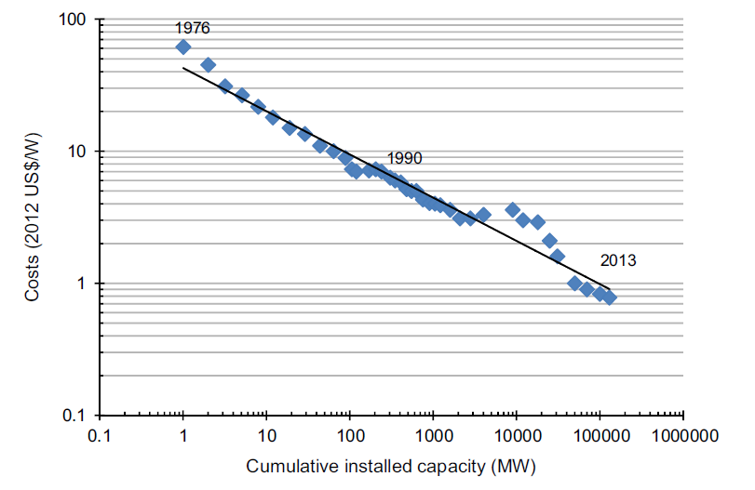
Learning Curve for PV modules (1976-2013)
European Energy Group Meeting, EPS, Lisboa, Nov. 13-14, 2014

Slide 7
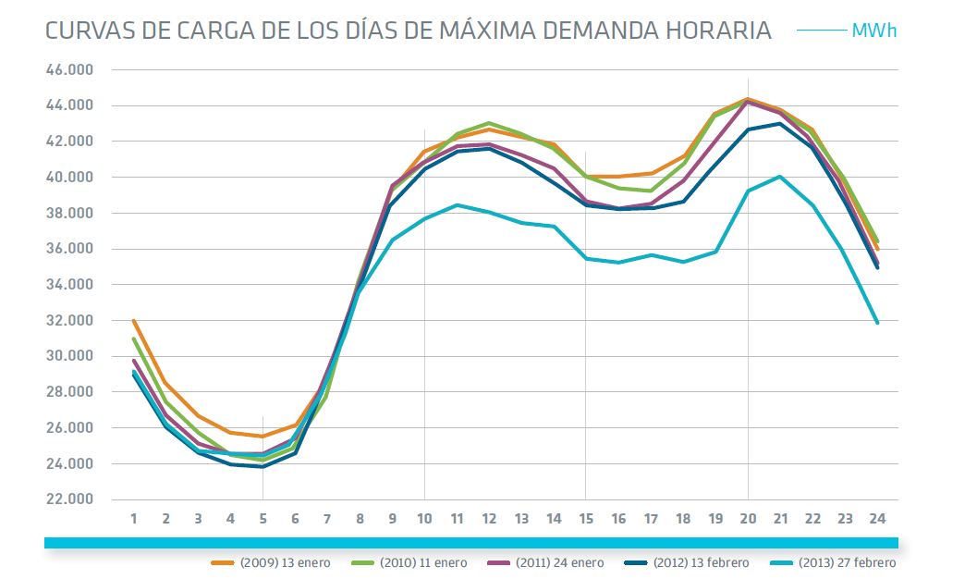
Power (MW) demand of electricity (2013) in Spain (The total installed power is about 100,000 MW)
Observe that maximum power demand is 44 GW (almost twice the minimum)
There is a large overcapacity since the system has more than 100 GW installed.
It should be considered the “Island effect” , (few interconnections), high % of renewables . .
European Energy Group Meeting, EPS, Lisboa, Nov. 13-14, 2014

Slide 8
Sources of electricity (2013) in Spain
European Energy Group Meeting, EPS, Lisboa, Nov. 13-14, 2014

Slide 9
Annual and accumulated electricity tariff deficit (to 2013).
(In million €)
Current Tarif deficit
39,000 M€
European Energy Group Meeting, EPS, Lisboa, Nov. 13-14, 2014

Slide 10
Evolution of bonuses to renewables in Spain (2006-2014*)
In million €
The amount of 7000 M€ estimated for 2014 corresponds to a reduction of about 2000 M€: 34% in wind, 13% in solar (PV and CSP), and other “renewables”
European Energy Group Meeting, EPS, Lisboa, Nov. 13-14, 2014

Slide 11
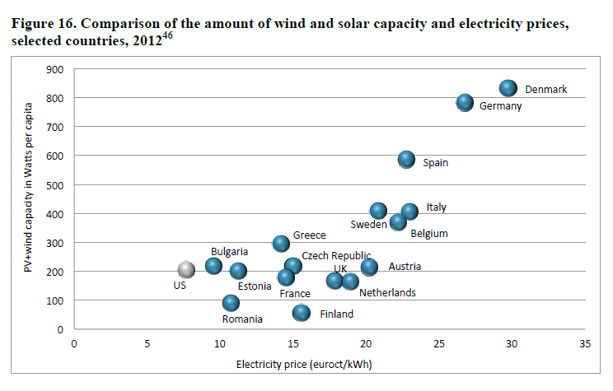

Slide 12
Appeals against the new Spanish Decree-law and international requests for commercial arbitration
- 350 requests presented to the Spanish Supreme Court against the new Decree-law (2014) regulating the new subsidies to renewables (PV, wind) which are about 40% less.
- The new Decree assigns a rentability for the renewable firms of 7.5% (in some cases about half of the previous one).
- 7 requests for commercial arbitration presented to the CIADI (World´s Bank) by funds, enterprises, etc. for the violation of the International Energy Treaty, signed in Lisbon 1994 by the EU and 52 additional countries
European Energy Group Meeting, EPS, Lisboa, Nov. 13-14, 2014

Slide 13
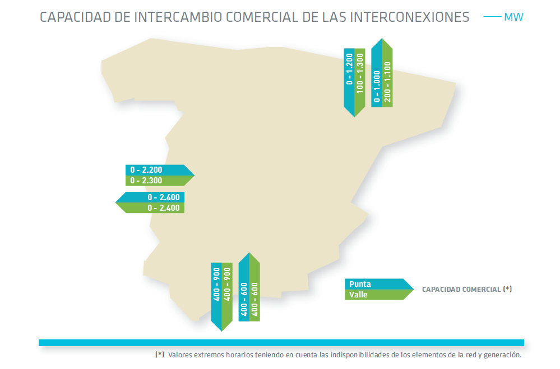
International interconnections: Spain Europe (I)
European Energy Group Meeting, EPS, Lisboa, Nov. 13-14, 2014

Slide 14
International interconnections (II)
- Spain is at present a kind of “Energy Island”: only 2% of power is interconnected.
- On Oct. 23, 2014 the EU adopted a plan of various interconnection projects, with the strong support of France, Portugal and Germany, and partly financed by the EU.
- Objective: 10% interconnections in 2020 and 15% in 2030 (current 2%).
- Advantages: (i) Less back-up power needed; (ii) Less overcapacity; (iii) Improve the ratio between electricity demand and total system power; (iv) Makes easier grid integration and requires less storage facilities.
European Energy Group Meeting, EPS, Lisboa, Nov. 13-14, 2014

Slide 15
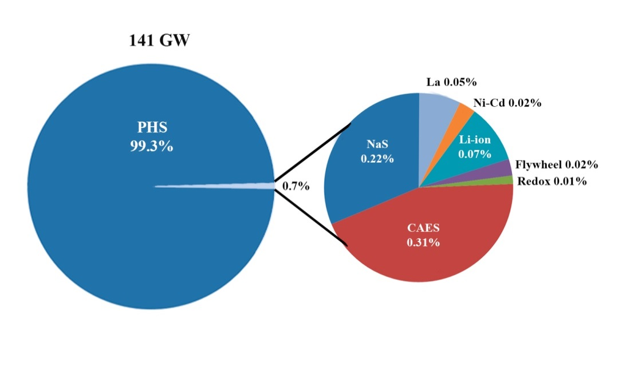
Electricity Storage (I)
-Of the total global electricity storage only about 1% is pumped-hydro.
-More electricity storage is needed for integration into the grid of high penetration (>30%) renewables.
-More and less expensive electrochical techniques are needed: batteries, supercapacitors, etc.
-Attention should be paid to the new Power-to-Gas technologies
European Energy Group Meeting, EPS, Lisboa, Nov. 13-14, 2014

Slide 16
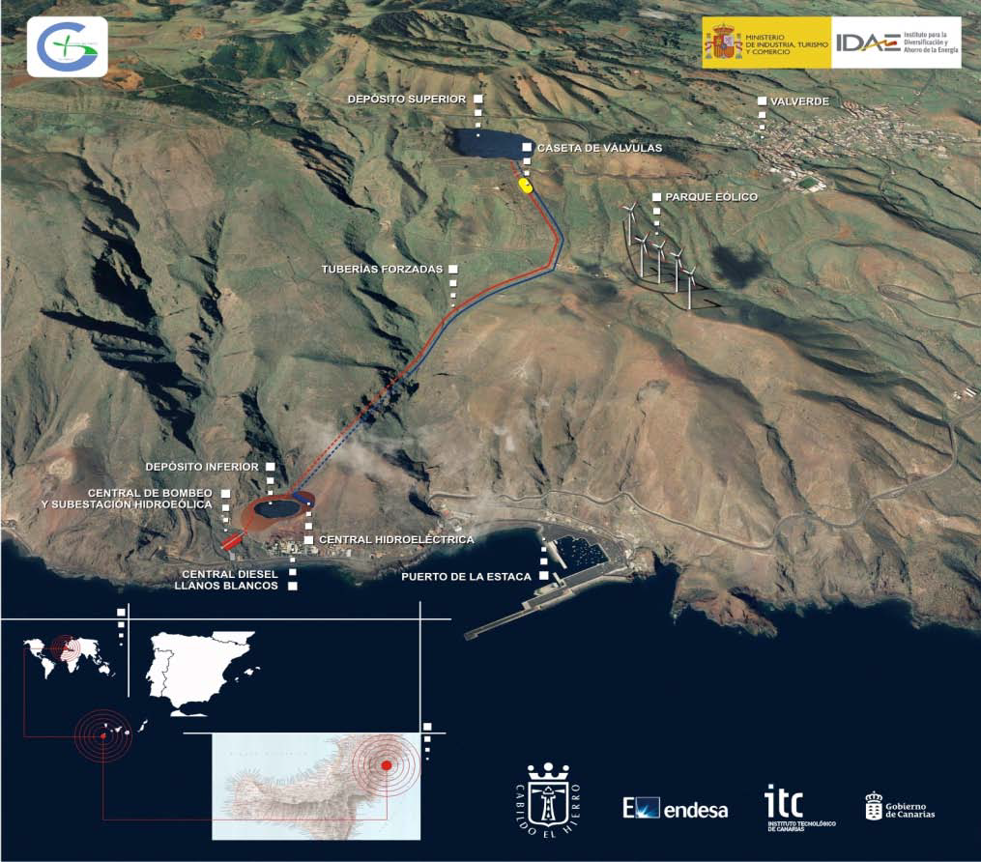
Electricity Storage (II): Pumped-hydro in Canary Islands
In mountainous countries like Spain pumped-hydro storage is very appropriate
European Energy Group Meeting, EPS, Lisboa, Nov. 13-14, 2014

Slide 17
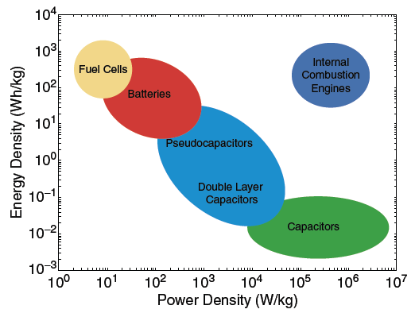
Electrochemical Storage (III): Energy and Power densities
European Energy Group Meeting, EPS, Lisboa, Nov. 13-14, 2014

Slide 18
Is Spain on track with the EU 20-20-20 Directive on renewable energy? Percentage of present situation (blue) and EU objective year 2020 (red)
-Spain with 14.3% in renewables, Portugal and Ireland do not show in 2012 enough progress in relation to their national plans to 2020. France and Holland are at present still very far to comply with the 20-20-20 EU objectives
European Energy Group Meeting, EPS, Lisboa, Nov. 13-14, 2014

Slide 19
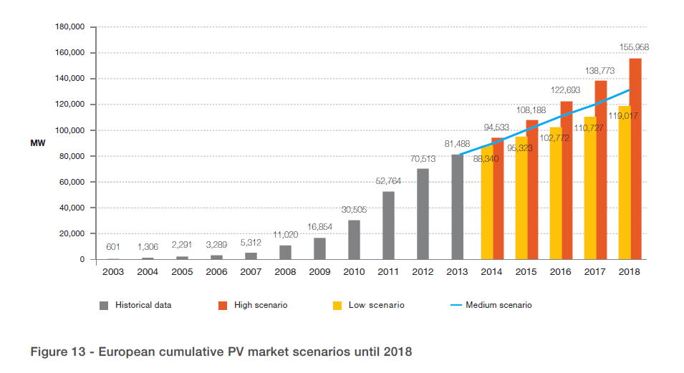
PV future prospects for Europe
European Energy Group Meeting, EPS, Lisboa, Nov. 13-14, 2014

Slide 20
Thank you for your attention!!!
For further questions please contact:
martinez.duart@uam.es
European Energy Group Meeting, EPS, Lisboa, Nov. 13-14, 2014

Slide 21
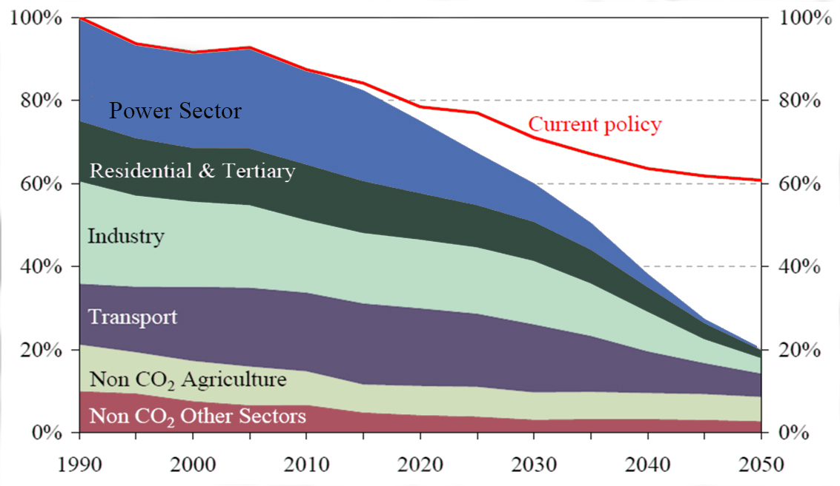
European 2050 Energy Roadmap and Targets
European Energy Group Meeting, EPS, Lisboa, Nov. 13-14, 2014

